Slide 1
Microsoft C Sharp
Basic Programming Constructs

Slide 2
Topics
What is looping
Types of loop
For
While
Do-While
Break statement
Continue statement
Nested Loops

Slide 3
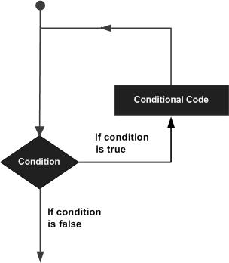
What is looping

Slide 4
Types of Loop
For
While
Do-While
Break statement
Continue statement
Nested Loops

Slide 5
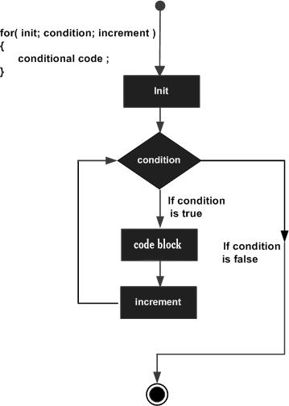
For Loop
for ( int i = 0 ; i < 20 ; i++ )
{
……..
}

Slide 6
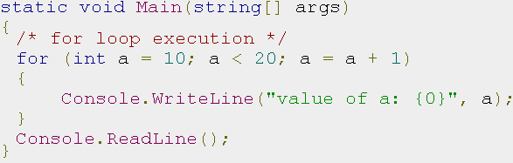
Example – for

Slide 7
Problems
Generate the following sequences with for
1,2,3,4,5,…..20
1,2,3,4,5,….N
0,2,4,6,8,……N
1,3,5,7,9,11,…..N
-30,-29,-28,-27…..5
-N,……,0,….. M
1,2,3,5,8,13,21,34,55,89,…..N

Slide 8
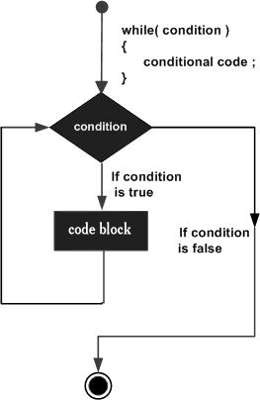
While - loop
while ( i < 20 )
{
……..
}

Slide 9
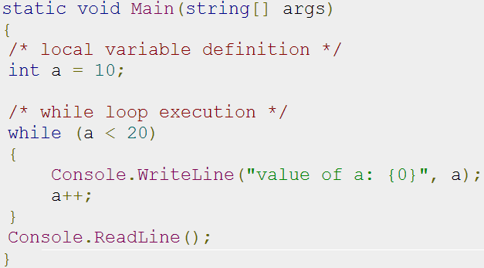
Example – while

Slide 10
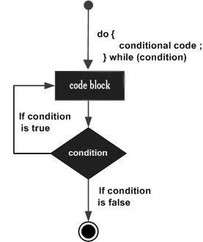
Do-While
do
{
……..
} while( i < 20 );

Slide 11
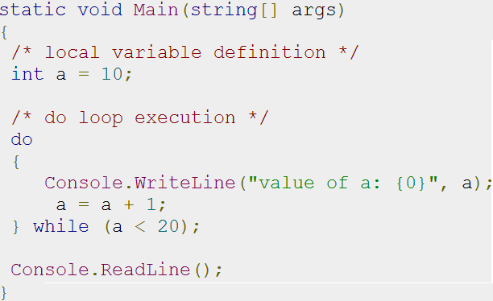
Example – do-while

Slide 12
Problems
Generate the following sequences with
while & do-while
1,2,3,4,5,…..20
1,2,3,4,5,….N
0,2,4,6,8,……N
1,3,5,7,9,11,…..N
-30,-29,-28,-27…..5
-N,……,0,….. M
1,2,3,5,8,13,21,34,55,89,…..N

Slide 13
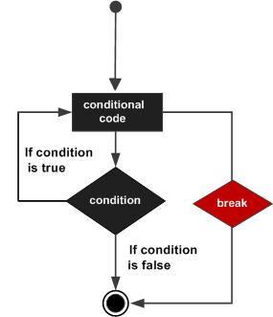
Break statement

Slide 14
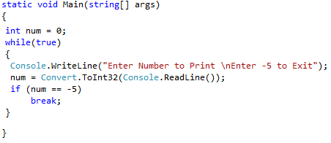
Example – break

Slide 15
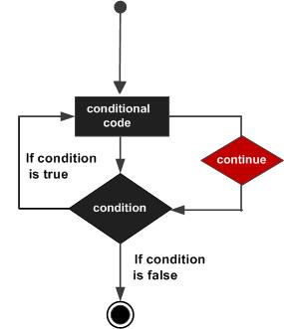
Continue Statement

Slide 16
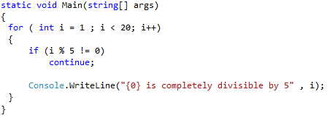
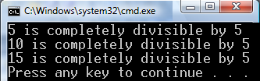
Example – continue

Slide 17
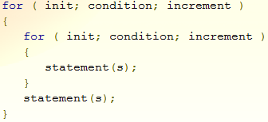
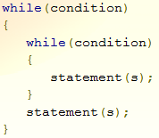
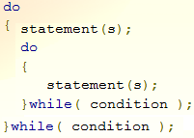
Nested loops

Slide 18
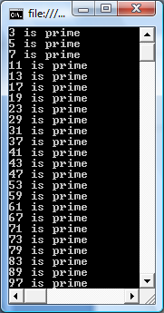
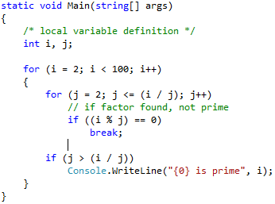
Example – Nested loops

